Slide 1

Sign Language Recognition System
[ Group No. 9 ] Team Members:
Ritesh Srivastava (17/ICS/076)
Mentor: Ritesh Vishwakarma (17/ICS/118)
Mr. Ankur Kumar Singhal Arpit Verma (17/ICS/014)
Anurag Kumar (17/ICS/012)

Slide 2
CONTENTS
Introduction
Objective
Tools And Technology
Steps
Flow Chart
Advantages
Challenges
Solutions
Applications
Result
Conclusion

Slide 3
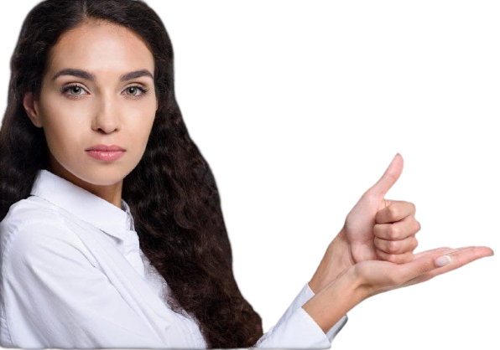
Introduction
About nine billion people in the world are deaf and dumb
Sign language helps differently abled people to communicate with other people

Slide 4
Objective
It aims to reduce or deduct the communication gap between normal and disabled people.
Communication for deaf person is achieved using AI

Slide 5
Tools And Technology
Software
Hardware
Visual Studio
Python
Keras (version 2.3.1)
Tensorflow (version 2.0.0)
Camera
Graphics card
Any desktop/Laptop system with higher level configuration

Slide 6
STEPS
Creating The Dataset
Predicting the data
Training a CNN on the captured dataset

Slide 7
START
Acquire Gesture
Flow Chart
Compare it with stored Gesture
If
Matched Found
Generate Corresponding text
STOP

Slide 8

DATASET
Total Samples
Training
Testing
27000
80.00%
20.00%

Slide 9
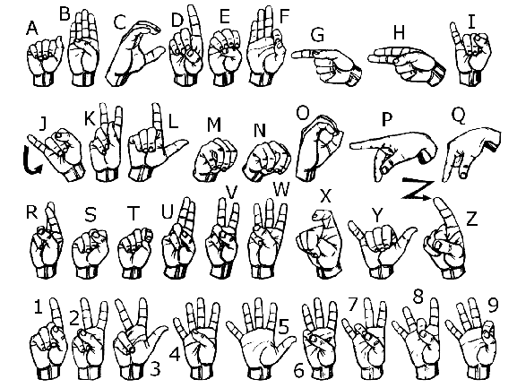
Sign Representation

Slide 10
Sign Language Detector
-------------
------------
---------------------
HI
I AM
RITESH

Slide 11
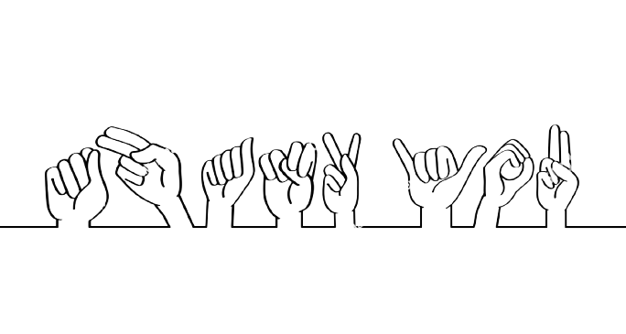
Working Model

Slide 12
Advantages
It makes communication possible for deaf and dumb people.
We do not need to learn sign language.
Provide an easy option for disable person to convey anything.

Slide 13
Challenges
Better Camera required
Convert Image from RGB to grayscale
Required large dataset
Difficult to identify similar signs like E,M,N,S

Slide 14
Solutions
To counter same sign issue..we had to make dedicated models for each problem .
We may need more and more data set to recognize the signs even with less resolution camera.

Slide 15
Applications
Hospitals
General Store
Police Stations
Bus and metro
Railway Station
Airports

Slide 16
Result
We have achieved an accuracy of 99% in training our model and 85% in a testing part.
We have used simple webcam instead of kinect devices.

Slide 17
Future Scope
Processing part should be improved so that System would be able to communicate in bi-directional way.
We will try to recognize signs which include motion.
Moreover we will focus on converting the sequence of gestures into text i.e. word and sentences and then converting it into the speech which can be heard.

Slide 18
CONCLUSION
In this report, a functional real time vision based american sign language
recognition have been developed for alphabets
We achieved final accuracy of 85.0% on our dataset.

Slide 19
REFERENCES
Mukesh Kumar Makwana, " Sign Language Recognition", M.Tech thesis, Indian Institute of Science, Bangalore
https://www.ijser.org/paper/Sign-Language-Recognition-System.html
T. Yamashita and T. Watasue, "Hand posture recognition based on bottom-up structured deep convolutional neural network with curriculum learning", 2014 IEEE International Conference on Image Processing (ICIP) , Paris, 2014, pp. 853-857.
https://www.sciencedirect.com/science/article/pii/S1877050917320720

Slide 20
Thank You

